Slide 1
Medical
Data
History
Analysis
M Y S Q L P R O J E C T

Slide 2
Objective
The Medical Data History Analysis project aims to improve healthcare delivery and operational efficiency by analyzing patient data using SQL, improving personalized care, optimizing resource allocation, supporting informed decision- making, and contributing to public health research, business growth by answering simple questions.

Slide 3
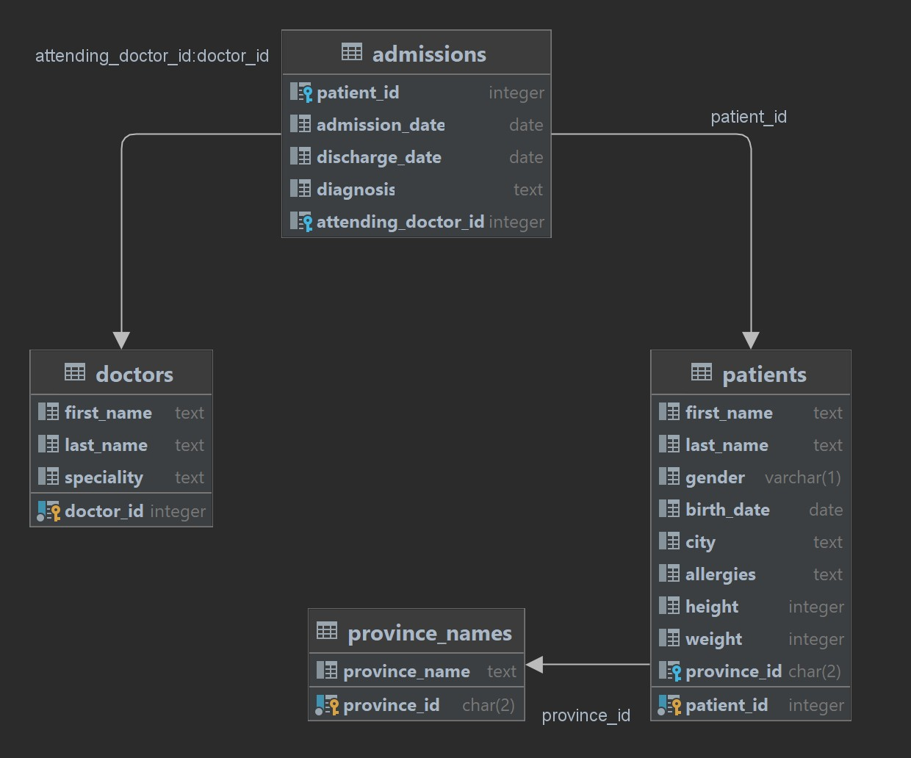
Database Schema Diagram

Slide 4
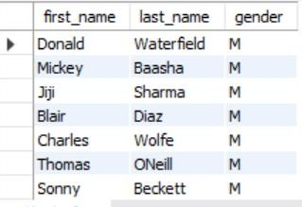
Q1 Show first name, last name, and gender of patients who's gender is 'M'.
INPUT
select first_name,last_name,gender
from patients
where gender= 'M';
OUTPUT
Insight
The 54.49 % of male patients aids in resource allocation, including assigning healthcare practitioners, optimizing bed allocation in male wards, and ensuring the availability of necessary medical supplies.

Slide 5
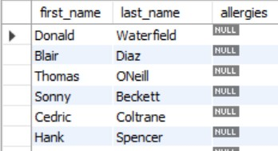
Q2 Show first name and last name of patients who does not have allergies.
INPUT
select first_name,last_name,allergies
from patients
where allergies is null;'M';
OUTPUT
Insight
There are 45.46% of patient without allergies helps in simplifying their medication plans, reducing the risk of adverse reactions, and focusing on other health conditions. This can improve patient care and streamline pharmacy operations.

Slide 6
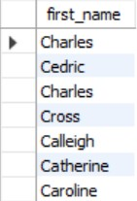
Q3 Show first name of patients that start with the letter 'C
INPUT
select first_name
from patients
where first_name like "C%";
';
OUTPUT
Insight
Identifying patients whose first names start with 'C' can provide insights into naming trends and demographic patterns within the patient population.

Slide 7
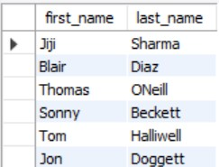
Q4 Show first name and last name of patients that weight within the range of 100 to 120 (inclusive)
INPUT
select first_name,last_name,weight
from patients
where weight between '100' and '120';
';
OUTPUT
Insight
21.02 % patients within a 100-120 kg weight range can help identify potential risk factors for weight-related conditions like diabetes, hypertension, or cardiovascular diseases, leading to proactive management and improved health outcomes.

Slide 8
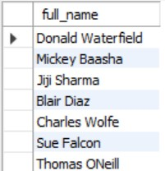
Q5. - Show first name and last name concatenated into one column to show their full name.
INPUT
select concat(first_name," ",last_name) as full_name
from patients;
';
OUTPUT
Insight
Concatenated names streamline data handling tasks like sorting, filtering, and report generation, reducing complexity and improving efficiency.

Slide 9
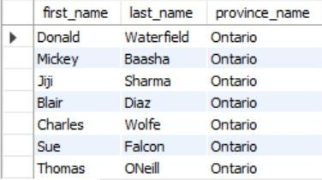
Q6 Show first name, last name, and the full province name of each patient..
INPUT
select first_name,last_name,province_name
from patients
join province_names
on patients.province_id = province_names.province_id;
';
OUTPUT
Insight
Healthcare organizations can design targeted campaigns and outreach programs based on the full province name, ensuring more effective and relevant healthcare interventions.

Slide 10
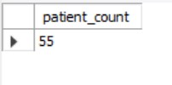
Q7 Show how many patients have a birth_date with 2010 as the birth year
INPUT
select count(*) as total_patients from patients
where year(birth_date) = '2010';
OUTPUT
Insight
2010 patient data can aid in age-specific health programs, resource allocation, vaccination management, community health programs, tracking health trends, and resource allocation, thereby improving planning and management of resources.

Slide 11

Q8 Show the first_name, last_name, and height of the patient with the greatest height.
INPUT
select first_name,last_name,height from patients
where height = (select max(height) from patients);
OUTPUT
Insight
The tallest patient's data can aid in understanding factors contributing to height, developing personalized care, and guiding training and injury prevention programs.

Slide 12
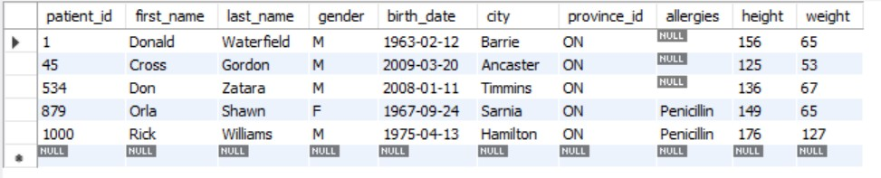
Q9 Show all columns for patients who have one of the following patient_ids: 1,45,534,879,1000ti
INPUT
select * from patients
where patient_id in (1,45,534,879,1000);
OUTPUT
Insight
Healthcare organizations can design targeted campaigns and outreach programs based on the full province name, ensuring more effective and relevant healthcare interventions.

Slide 13

Q10 :- Show the total number of admissions.
INPUT
select count(*) as total_admissions from admissions;
OUTPUT
Insight
This data is essential for healthcare utilization analysis, resource planning, financial management, and policy development.

Slide 14
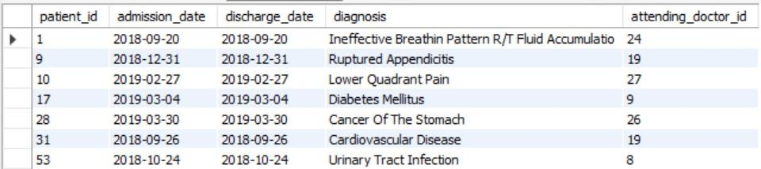
Q11:- Show all the columns from admissions where the patient was admitted and discharged on the same day.
INPUT
select * from admissions
where admission_date = discharge_date;
OUTPUT
Insight
9.5% of patients are admitted and discharged on the same day, indicating short-term care efficiency and resource utilization. Comparative analysis and benchmarking can identify areas for improvement.

Slide 15

Q12:- Show the total number of admissions for patient_id 579.
INPUT
select patient_id,count(patient_id) as total_admissions
from admissions
where patient_id = 579;
OUTPUT
Insight
Frequent patient admissions can reveal chronic conditions, need for better care coordination, resource allocation, historical trends, comparative analysis, and outcome analysis, enhancing patient care and management by assessing quality and patient outcomes

Slide 16
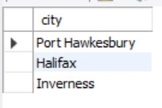
Q13 Based on the cities that our patients live in, show unique cities that are in province_id 'NS'?
INPUT
select distinct city from patients where province_id = 'NS';
OUTPUT
Insight
Understanding patient population distribution is crucial for service planning, resource allocation, facility location, marketing, and community engagement. Cross-referencing cities maintains data quality, analyzing trends for expansion and location decisions

Slide 17
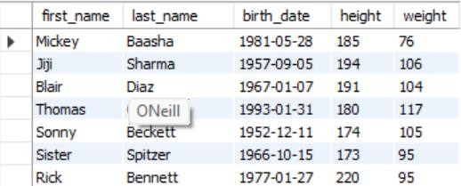
Q14:- Write a query to find the first_name, last name and birth date of patients who have height more
than 160 and weight more than 70.
INPUT
select first_name,last_name,birth_date,height,weight from patients
where height > 160 and weight > 70;
Insight
OUTPUT
46.15 % overweight individuals face health risks like hypertension, diabetes, heart disease, and cancer. Lifestyle changes, regular screenings, intervention programs, and personalized health plans can address these issues. Comprehensive health assessments help gauge intervention effectiveness.

Slide 18
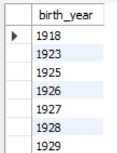
Q15 Show unique birth years from patients and order them by ascending.
INPUT
select distinct year(birth_date) as birth_year from patients
order by birth_year;
Insight
OUTPUT
Understanding unique birth years aids in tailoring healthcare services to different age groups, identifying predominant generations, and understanding generational health trends. This information is crucial for planning, resource allocation, and predictive modeling, enabling the development of health interventions.

Slide 19
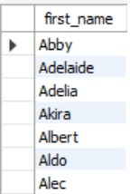
Q16 Show unique first names from the patients table which only occurs once in the list.
INPUT
select first_name from patients
group by first_name
having COUNT(first_name) = 1;
Insight
OUTPUT
Analyzing unique first names in patient records enhances data quality, identifies unique cases, aligns with privacy, provides insights into naming trends, personalizes communication, manages large datasets, and identifies outliers.

Slide 20
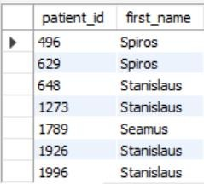
Q17 Show patient_id and first_name from patients where their first_name start and ends with ‘s’
and is at least 6 characters long.
INPUT
select patient_id, first_name from patients
where first_name like ‘s____%s';
Insight
OUTPUT
Name patterns reveal unique trends, cultural influences, and demographic insights, aiding in data quality, patient engagement, and communication strategies, while ensuring consistency in data management.

Slide 21
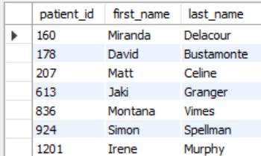
Q18 Show patient_id, first_name, last_name from patients whos diagnosis is 'Dementia'. Primary diagnosis is stored in the admissions table.
INPUT
select p.patient_id, p.first_name, p.last_name from patients p
join admissions a on p.patient_id = a.patient_id where diagnosis = 'Dementia';
Insight
OUTPUT
Understanding dementia prevalence helps plan care services, allocate resources, and forecast future healthcare needs. Demographic factors, age distribution, and gender can be analyzed for personalized care plans, guiding clinical focus, improving care quality, and ensuring data quality.

Slide 22
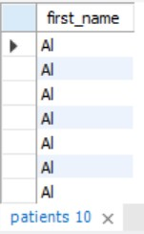
Q19 Display every patient's first_name. Order the list by the length of each name and then by alphbetically.
INPUT
select first_name from patients
order by length(first_name), first_name;
Insight
OUTPUT
Sorting names by length offers valuable insights into naming conventions, data quality, cultural trends, operational efficiency, personalized communication, and database management, identifying anomalies and optimizing queries..

Slide 23

Q20 Show the total amount of male patients and the total amount of female patients in the patients table. Display the two results in the same row.
INPUT
select sum(gender = 'M') as male_count, sum(gender = 'F') as female_count
from patients;
Insight
OUTPUT
The data shows that male patients constitute approximately 54.5% of the total patient population, while female patients make up about 45.5%. This indicates a slightly higher prevalence of male patients in the dataset.

Slide 24
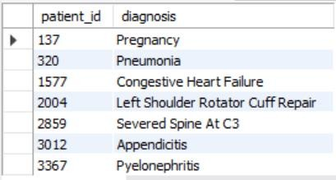
Q21 Show patient_id, diagnosis from admissions. Find patients admitted multiple times for the same diagnosis.
INPUT
select patient_id, diagnosis from admissions
group by patient_id, diagnosis
having COUNT(diagnosis) > 1;
Insight
OUTPUT
Chronic conditions like diabetes, heart disease, and COPD require frequent hospitalizations, indicating challenges in effective management. Improved follow-up care, patient support, and resource utilization can manage costs and improve care quality. Data-driven decisions can inform policy making, focusing on chronic disease management programs and resource allocation.

Slide 25
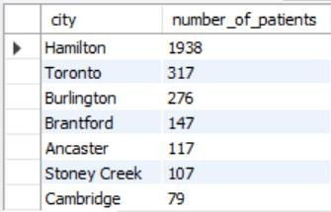
Q22 Show the city and the total number of patients in the city. Order from most to least patients and then by city name ascending.
INPUT
select city, COUNT(*) as number_of_patients from patients
group by city
order by number_of_patients desc, city asc;
Insight
OUTPUT
Hamilton has the highest percentage of patients, making up 42.78% of the total patient population. It requires significant healthcare resources and infrastructure; other cities have less than 7% of the patient population.

Slide 26
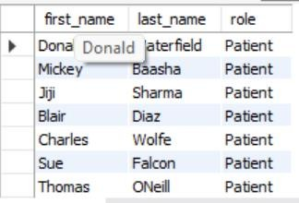
Q23 Show first name, last name and role of every person that is either patient or doctor. The roles are either "Patient" or "Doctor".
INPUT
select first_name, last_name, 'Patient' as role from patients
union all
select first_name, last_name, 'Doctor' as role from doctors;
OUTPUT
Insight
This query will display the first name, last name, and role of every person who is either a patient or a doctor.

Slide 27
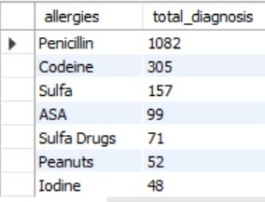
Q24 Show all allergies ordered by popularity. Remove NULL values from query.
INPUT
select allergies, count(*) as total_diagnosis
from patients
where allergies is not null group by allergies
order by total_diagnosis desc;
OUTPUT
Insight
Penicillin allergies are most prevalent among the 43.78 % population.

Slide 28
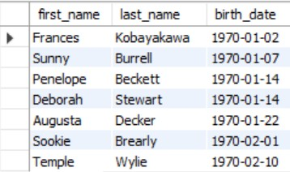
Q25 Show all patient's first_name, last_name, and birth_date who were born in the 1970s decade. Sort the list starting from the earliest birth_date.
INPUT
select first_name,last_name,birth_date
from patients
where year(birth_date) between 1970 and 1979 order by birth_date ;
OUTPUT
Insight
Congestive Heart Failure is present in 5.18 percent of persons age 44 to 53.

Slide 29

Q26 We want to display each patient's full name in a single column. Their last_name in all upper letters must appear first, then first_name in all lower case letters. Separate the last_name and first_name with a comma. Order the list by the first_name in decending order.
INPUT
select concat(upper(last_name), ',', lower(first_name)) as new_name_format
from patients
order by first_name desc;
OUTPUT
Insight
This approach ensures that the names are displayed in the specified format and order.

Slide 30
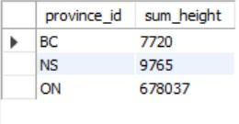
Q27 Show the province_id(s), sum of height; where the total sum of its patient's height is greater than or equal to 7,000.
INPUT
select pr.province_id, sum(pa.height) as sum_height from province_names pr
join patients pa on pr.province_id = pa.province_id group by pr.province_id
having sum(pa.height) >= 7000;
OUTPUT
Insight
Provinces: Ontario, Nova Scotia, British Columbia whose patient's height as a whole is greater than or equal to 7,000. This suggests that the average height of provinces in that area is higher.

Slide 31

Q28 Show the difference between the largest weight and smallest weight for patients with the last name 'Maroni'.
INPUT
select (max(weight) - min(weight)) as weight_diff from patients
where last_name = 'Maroni';
OUTPUT
Insight
The calculated difference between the largest and smallest weights for patients with the last name 'Maroni' indicates the range of weights within this group.

Slide 32
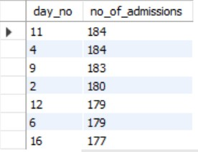
Q29 Show all of the days of the month (1-31) and how many admission_dates occurred on that day. Sort by the day with most admissions to least admissions.
INPUT
select day(admission_date) as day_no, count(patient_id) as no_of_admissions from admissions
group by day_no
order by no_of_admissions desc;
OUTPUT
Insight
The highest number of admissions recorded in a single day is 184. On average, there are 164 admissions per day.

Slide 33
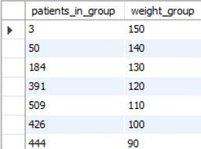
Q30 Show all of the patients grouped into weight groups. Show the total amount of patients in each weight group. Order the list by the weight group decending. e.g. if they weight 100 to 109 they are placed in the 100 weight group, 110-119 = 110 weight group, etc.
INPUT
select floor(weight / 10) * 10 as weight_group, count(*) as total_patients
from patients
group by weight_group order by weight_group desc;
OUTPUT
Insight
The weight group 60 has the highest concentration of patients, indicating a significant portion of the patient population falls within this weight range.

Slide 34
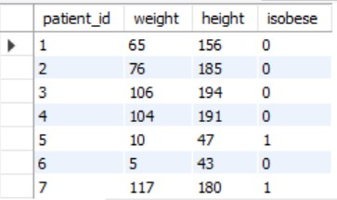
Q31 Show patient_id, weight, height, isObese from the patients table. Display isObese as a boolean 0 or 1. Obese is defined as weight(kg)/(height(m). Weight is in units kg. Height is in units cm.
INPUT
select patient_id,weight,height, case
when weight / power(height / 100.00, 2) >= 30
then 1
else 0
end as isobese from patients;
OUTPUT
Insight
49.05% of the patients are classified as obese

Slide 35

Q32 Show patient_id, first_name, last_name, and attending doctor's specialty. Show only the patients who has a diagnosis as 'Epilepsy' and the doctor's first name is 'Lisa'. Check patients, admissions, and doctors tables for required information.
INPUT
select p.patient_id, p.first_name, p.last_name,d.specialty from patients p
inner join admissions a on p.patient_id = a.patient_id
inner join doctors d on a.attending_doctor_id = d.doctor_id where a.diagnosis = 'Epilepsy'and d.first_name = 'Lisa';
OUTPUT
Insight
The insight from this query would provide a list of patients who have been diagnosed with epilepsy and are under the care of a doctor named Lisa. It can be used for performance reviews and to understand which doctors are handling specific conditions most frequently.

Slide 36
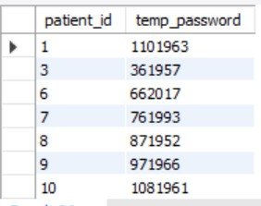
Q33 All patients who have gone through admissions, can see their medical documents on our site. Those patients are given a temporary password after their first admission. Show the patient_id and temp_password.
INPUT
select distinct p.patient_id, concat(a.patient_id, length(p.last_name), year(p.birth_date)) as temp_password from patients p
inner join admissions a on p.patient_id = a.patient_id;
OUTPUT
Insight
Generating temporary passwords based on patient-specific information ensures secure and personalized access to medical records. This approach enhances patient data security and ease of access to their medical history.

Slide 37
Profile Links :-
LinkedIn Profile : www.linkedin.com/in/ajay-wadile-994bb7255
GitHub Profile : https://github.com/ajwadile
Mail Id : ajaywadile1406@gmail.com
Mobile No. : 7767085863
THANK YOU

